Slide 1
Sentiment Analysis for Political Campaigns
Submitted in the partial fulfillment for the award of the degree of
BACHELOR OF ENGINEERING
IN
COMPUTER SCIENCE AND SEPCIALIZATION IN
ARTIFICIAL INTELLIGENCE AND MACHINE LEARNING
Submitted by:
22BAI71302 Deshaveni Akshar Rao
22BAI71074 Madishetty Soumith
22BAI71236 Devisetti Guru Sai
22BAI70360 Kothalanka Siva Ganesh
Under the Supervision of:
DR. Navjeet Kaur
Department of AIT-CSE
DISCOVER . LEARN . EMPOWER

Slide 2
Outline
Introduction to Project
Problem Formulation
Objectives of the work
Methodology used
Results and Outputs
Conclusion
Future Scope

Slide 3
Introduction to Project
Social media = major platform for political conversation.
Sentiment analysis = crucial for understanding voter behavior.
Sentiment analysis allows us to quantify public emotions—positive, negative, or neutral.
It helps political parties, strategists, and researchers understand the prevailing public opinion during campaigns.
Focus: Indian elections, especially the BJP and Congress, 2019.
To classify them into positive, negative, and neutral sentiments using Machine Learning models.

Slide 4
Problem Formulation
Challenges in Political Sentiment Analysis:
Tweets often contain slang, sarcasm, abbreviations, and multilingual content.
Sentiments on social media change rapidly, requiring dynamic models.
Datasets for Indian political sentiments are limited compared to global datasets.
Research Gap: Previous research focuses mainly on global political datasets,
Neglecting regional political contexts like India’s.
Problem Statement:
How can machine learning models accurately capture and predict voter sentiment from
noisy and diverse political tweet data?

Slide 5
Objectives of the Work
Primary Goal:
To build machine learning models that can accurately classify the
sentiment of political tweets.
Specific Objectives:
Collect and clean real-world political tweet data from Indian elections.
Apply TF-IDF and Bag of Words (BoW) techniques for feature extraction.
Train multiple machine learning models like Logistic Regression, Decision Trees,
SVM, Naive Bayes, and XGBoost.
Compare the performance of these models to find the most effective one.
Visualize and interpret the dominant themes, parties, and sentiment patterns.

Slide 6
Methodology used
Dataset: Kaggle’s Indian Election Tweets (2019) - 79,730 tweets (BJP: 49,478 and Congress: 30,253).
Data Preprocessing:
Cleaning text (removing URLS, mentions, hashtags, emojis).
Tokenization, stopword removal, stemming, lemmatization.
Feature Extraction: TF-IDF Vectorizer, Bag of Words (BoW).
Models: Logistic Regression, Decision Tree, Naive Bayes, XGBoost, Linear SVC.
Logistic Regression:
A simple and effective algorithm for binary and multi-class classification.
Uses a sigmoid activation function to predict the probability of sentiment classes.

Slide 7
Naive Bayes Classifier:
Based on Bayes' Theorem, assumes independence between features.
Particularly effective for text classification tasks (even if the independence assumption is not fully true).
Decision Tree Classifier: Builds a tree-like structure where each node represents a decision
rule based on features.
XGBoost (Extreme Gradient Boosting): Advanced ensemble technique based on boosting
multiple weak learners (small decision trees).
Linear SVC (Support Vector Classifier): Specialized for high-dimensional sparse datasets like
TF-IDF vectors.
Sentiment Annotation: Used VADER for assigning positive, negative, or neutral sentiment scores.

Slide 8
Results and Outputs
Model Performance:
Decision Tree (TF-IDF) achieved the highest accuracy of 93.40%.
Logistic Regression and Linear SVC performed moderately well (~82.7%).
XGBoost and Naive Bayes had lower performance (79.85% and 74.10%).
Findings from Analysis:
BJP-related tweets had higher engagement and sentiment polarity.
Common keywords: "Modi", "Rahul Gandhi", "BJP", "Congress", "vote", "elections".
Majority of tweets during elections were positive.
Accuracy Comparison Charts:
TF-IDF + Decision Tree > 93%.
TF-IDF + Logistic Regression ≈ 82%.
Sentiment Distribution Charts: Positive > Negative > Neutral.
Confusion Matrix: High true positive and true negative rates.

Slide 9
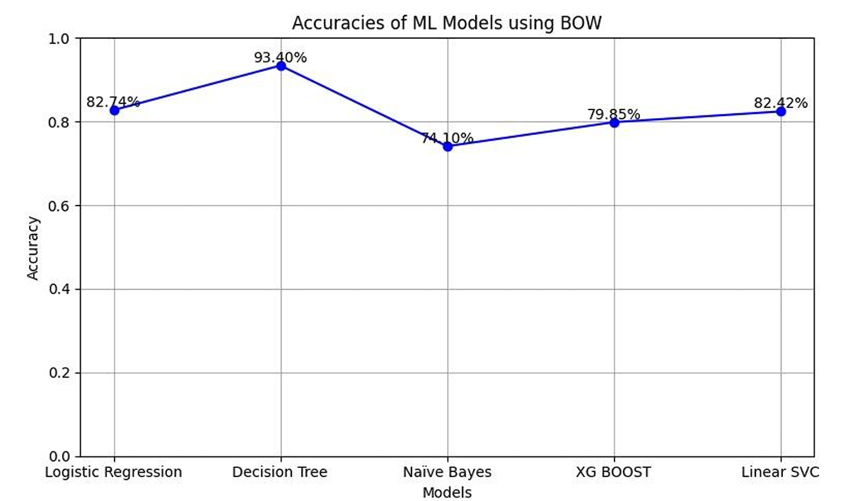
Performance Comparison of ML Models (BoW Features)
Add a clean heading and show this graph as the center of attention.
Under the graph, write a 2-line analysis: Decision Tree outperforms
others with 93.40% accuracy.Logistic Regression and Linear SVC show
comparable results (~82%).

Slide 10
Conclusion
Sentiment analysis effectively captures and predicts public mood during elections.
Decision Tree models combined with TF-IDF features deliver the best accuracy.
Political strategists can use social media sentiment to modify campaigns and policies.
Machine Learning provides scalable and rapid analysis of large datasets,
important for fast-changing social media trends.

Slide 11
Future Scope
Advanced Models: Use deep learning models like BERT, LSTM
for better context understanding.
Regional Language Integration: Expand analysis to Hindi, Telugu, and Marathi
tweets to include wider demographics.
Real-Time Sentiment Monitoring: Develop dashboards that track voter sentiment
live during elections.
Bot and Spam Detection: Filter out artificial accounts to ensure genuine sentiment analysis.
Aspect-Based Sentiment Analysis: Analyse sentiments based on leaders, policies,
and events separately.

Slide 12
Thank You

